Slide 1
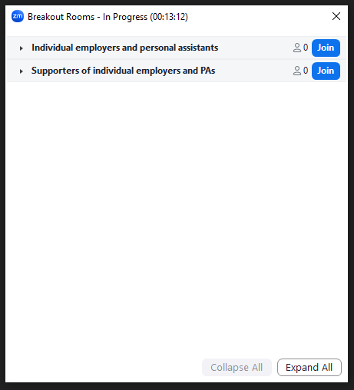
Choose your networking group
Click on the breakout rooms button in your toolbar.
If you’re using a smaller screen, the breakout rooms icon may not appear in your toolbar in which case you’ll need to click ‘more’ and then ‘join breakout room’.
A pop-up window will appear.
If you’re an individual employer or a personal assistant, click ‘Join’ next to that room.
If you’re someone who supports individual employers and personal assistants, click ‘Join’ next to that room.
If the breakout room button doesn’t show for you, put your name in the chat box along with which group you fit into, and a colleague will move you manually.

Slide 2
Skills for Care offer for individual employers and those who support them
Notes:
If you employ a personal assistant (PA) using a direct payment from your local authority, a personal health budget from the NHS or with your own money, we have a range of resources to help you.

Slide 3
Why employ a PA?
Employing a personal assistant (PA) gives you more choice and control.
you decide what you want them to do
you decide when & where you want them to work
going to work or college
exercising
health tasks
shopping
personal care
socialising
appointments
cooking

Slide 4
“This is the only path for true independence, choice and control.”
Nadia Clarke, Individual Employer

Slide 5
Steering group
Steering group
Individual employers
PAs
Local authorities
NHS Provider
ULOs
TLAP
Unison
Funders – DHSC & NHSEI
Pensions regulator
Insurance providers
DPSOs
Learning providers
Notes:
The work Skills for Care does to support individual employers, PAs and the organisations supporting them, isn't done in isolation.
We have an engaged group of representatives who help steer our work. They meet quarterly and discuss issues in relation to employing PAs, learning and development. They tell us what’s happening in their networks and share what we are doing. They are often consulted on by government and academics to seek their views and engage with the wider public.
They also get involved in our work by coproducing, consulting and sense checking our resources.
The group consists of…
Social care and PHB funded employers
Local authority direct payment teams
Local authority training department
Direct payment support organisations
NHS provider
User led-organisations
Think Local Act Personal National Co-production Advisory Group
Unison
Our funders – DHSC and NHS England and NHS Improvement
The Pensions Regulator
Insurance

Slide 6
Information hub for individual employers and PAs
Our website has links to practical advice, guidance and resources for:
Individual employers
Personal assistants (PAs)
People who support individual employers and PAs
Links to local support organisations, funding and quarterly newsletter
https://www.skillsforcare.org.uk/Recruitment-support/Support-individual-employers-PAs/Support-for-individual-employers-and-PAs.aspx
Notes:
You can find practical advice, guidance and resources in one place on Skills for Care's information hub.
Not only resources available from Skills for Care, but other trusted sources and those organisations we have worked with.
This also includes links to videos of real PAs and employers, webinars and recordings of presentations given during events and workshops.
Here you can also find links to local support organisations, funding (both IE and ULO funding) and to sign up to our quarterly newsletter.

Slide 7
Recorded Webinars
Delegating healthcare tasks to personal assistants
Keeping safe online
Preparation for better conversations
Understanding your responsibilities as an employer of PAs
Wellbeing for individual employers and those supporting them
Learning and development and accessing funding
Recruiting personal assistants during a pandemic
Planning, keeping safe, and being prepared
Notes:
Over the past few years we’ve run a number of webinars to support employers and PAs with understanding responsibilities, conversations, wellbeing, recruiting, funding and workforce planning.
Some of these were developed during the pandemic but the subjects they cover are useful and may still be relevant.
More will be added as they are developed.
If there is demand for a webinar on a particular theme/topic, get in touch.

Slide 8
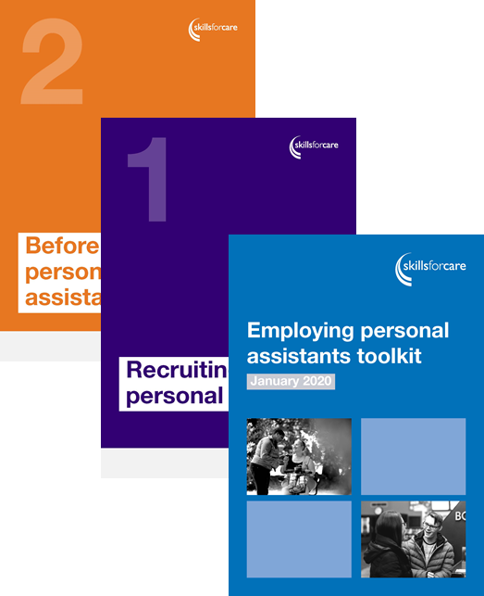
Employing personal assistants toolkit
This toolkit includes information about:
recruiting a personal assistant
before your personal assistant starts
managing your personal assistant
training and qualifications
sorting our problems.
The toolkit is also available in Easy read.
Email marketing@skillsforcare.org.uk for a free printed copy or visit www.skillsforcare.org.uk/PAtoolkit
Notes:
One of the main resources you'll find on the hub is to support employers with recruiting and managing their personal assistants is the Skills for Care employing personal assistants toolkit. It can be accessed in different formats, including Easy Read and can be requested as a paper copy.

Slide 9
Values based recruitment
March 2023 – workshop recordings
News article about the recordings
Values Based Recruitment (VBR) – what does it mean?
VBR: Articulate - Knowing what your values and culture are and sharing that with new and existing PAs
VBR: Attract - Advertising your roles to people who share your values
VBR: Apply - Shortlisting and selecting PAs who demonstrate values in the application process
VBR: Assess - Using values based ways of assessing if candidates share your values and are the right person to be your PA
VBR: Assimilate - Inducting, developing and managing new and existing PAs to ensure they demonstrate the values and behaviours that matter in their PA role
VBR: PA's perspective
Notes:
This slide will be updated with links to the presentations from the values based recruitment workshop held in March 2023.
The workshop was an introduction to the fundamentals of values based recruitment and featured Kerry Cleary from VBA Consulting and expert in values based recruitment as well as perspectives from individual employers and personal assistants.

Slide 10
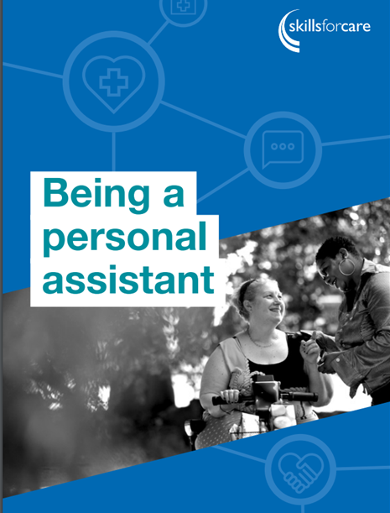
Question of Care: PA scenario
www.skillsforcare.org.uk/beingaPA
www.skillsforcare.org.uk/Careers-in-care/news-events/A-Question-of-Care-has-been-updated....aspx
Notes:
People who want to know more about the PA role, can also access resources and videos on the information hub. This includes
Being a personal assistant which explains more about the role, why it’s a great job and how to find work and much more.
Videos of real personal assistants sharing what they love about the role.
A Question of Care can be used by people interested in working in social care. Employers can use it as a profiling tool during the recruitment process, to assess whether candidates have the right values and behaviours. Look out for Ben who works as a PA and follow the scenarios he encounters.

Slide 11
A way of agreeing how we will work together: a guide and template
Sets out what PAs can expect from their employer and what employers can expect from their PAs (in a similar way to a code of conduct).
Basis of an ongoing conversation
Guide and downloadable template
Notes:
A way of agreeing how we will work together: a guide for individual employers and personal assistants
These resources have been developed with individual employers and personal assistants. They’re for people who employ personal assistants (PAs) to support them to live a life they want to lead; engaging in all the things they want to do in their life, and set out what PAs can expect from their employer and what employers can expect from their PAs (in a similar way to a code of conduct). It’s recommended that both resources be used at the beginning, during and throughout your working relationship. They can also be used during a work trial, as part of induction, at supervision or regular reviews and form the basis of an ongoing conversation between employer and PA, and where rele­vant the wider team and circle of support. - A way of agreeing how we will work together: a guide for individual employers and personal assistants leaflet, gives an overview of how employers and PAs should work together and what employers and PAs will do. - The accompanying template can be personalised and be used to expand on what will make your unique working relationship work.

Slide 12
Individual employer funding
Individual employers can apply for funding to pay for training for themselves and their PAs.
The funding can pay for the cost of:
training (we fund lots of different training courses)
travel to and from training
hiring a replacement PA.
www.skillsforcare.org.uk/IEfunding
Notes:
IEs can apply for funding anytime up to end of 15 March 2024

Slide 13
Applications from ULO’s Open Now!!
How to apply
Visit this page; User Led Organisation Funding - Skills for Care
Read the guidance
Complete both the application form and full cost breakdown spreadsheet and
send them both to funding@skillsforcare.org.uk by midday on Friday 14 June 2024.
We’re running Q&A sessions for anyone who has questions about the funding or completing the application process. These will be on:
Fri 17 May 2024 at 13.30 – 14.30
Wed 5 June 2024 at 10:00 – 11:00
If you would like to attend please email funding@skillsforcare.org.uk
Any questions? Please contact funding@skillsforcare.org.uk or call 0113 241 1275

Slide 14
This year (April 2024-March 2025).The IE/PA funding is extended to people who
live in England
are a self-employed PA adult (self- employment evidence needed)
are an adult and employ or contract* their own care and support (also known as a personal assistant or PA) using
a personal budget from social care, or
personal health budget or their own money
(n.b. “contracted” PAs refers to PAs with true self-employed status).
Notes:
NHS England has recently published a Personal Health Budget Quality framework which clearly outlines Integrated Care Board responsibilities for training and development. It states that ‘Sufficient funding is available in PHBs to cover the additional necessary costs of employment, if required, such as, training and development, and this is clearly explained to people before they recruit personal assistants.
A PHB uses NHS funding to create an individually agreed personalised care and support plan that offers people of all ages greater choice and flexibility over how their assessed health and wellbeing needs are met. The principles of the NHS is that services are available to all, based on clinical need not on ability to pay and therefore a person’s PHB should support the health and wellbeing needs which have been planned and agreed with the person’s NHS team.
People employing PAs using a PHB will need to discuss training requirements for PAs with their PHB provider. For example, if a person’s care plan outlines support PAs will be providing to their employers (e.g. medication, assisting and moving, communication etc.) and their PAs require training to be able to provide that support, then the ICB has responsibility for funding the training and development.

Slide 15
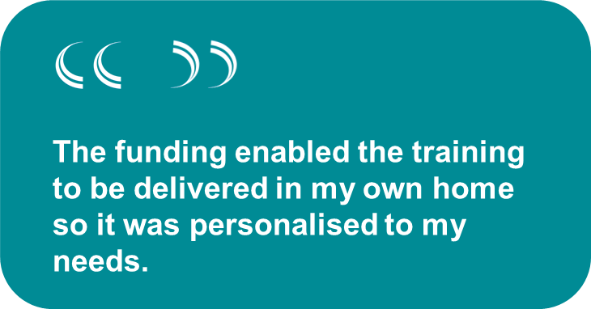
What types of training can I apply for?
We fund lots of different training courses, and we look at each application on a case by case basis.
being a good boss
moving and handling
first aid
communication skills
social care qualifications
nutrition and hydration
induction training

Slide 16
User led organisation (ULO) funding
Each year, we disburse funding to ULOs to deliver training for individual employers and PAs.
We funded 22 organisations in 2023/24. Organisaitons will be able to apply for 24 / 25 funding in spring 2024
To find out what training has been funded follow the link and contact the organisations to access the training.
www.skillsforcare.org.uk/ULOfunding
Notes:
We award funding once a year to organisations who are run and controlled by people who use their services to delivery programmes of learning for PAs and their employers. This can include pre-employment (support the knowledge of people to become PAs) and pre-employment training (for people who are going to employ PAs).
The organisations aim to deliver a range of training courses for PAs and individual employers, who may achieve thousands of learning outcomes.
More information about the training being offered by the ULOs, go to www.skillsforcare.org.uk/ulofunding
NHS England has recently published a Personal Health Budget Quality framework which clearly outlines Integrated Care Board responsibilities for training and development. It states that ‘Sufficient funding is available in PHBs to cover the additional necessary costs of employment, if required, such as, training and development, and this is clearly explained to people before they recruit personal assistants.
A PHB uses NHS funding to create an individually agreed personalised care and support plan that offers people of all ages greater choice and flexibility over how their assessed health and wellbeing needs are met. The principles of the NHS is that services are available to all, based on clinical need not on ability to pay and therefore a person’s PHB should support the health and wellbeing needs which have been planned and agreed with the person’s NHS team.
People employing PAs using a PHB will need to discuss training requirements for PAs with their PHB provider. For example, if a person’s care plan outlines support PAs will be providing to their employers (e.g. medication, assisting and moving, communication etc.) and their PAs require training to be able to provide that support, then the ICB has responsibility for funding the training and development.

Slide 17
You can access ULO funding and training if you..
live in England
are an adult and employs or contracts * their own care and support
prospective PAs as part of a structured pre-employment programme.
pre-employer training for those pre-approved for a social care direct payment or personal health budget.
Self Employed PA's (Need to provide evidence of legal self-employment)
Notes:
NHS England has recently published a Personal Health Budget Quality framework which clearly outlines Integrated Care Board responsibilities for training and development. It states that ‘Sufficient funding is available in PHBs to cover the additional necessary costs of employment, if required, such as, training and development, and this is clearly explained to people before they recruit personal assistants.
A PHB uses NHS funding to create an individually agreed personalised care and support plan that offers people of all ages greater choice and flexibility over how their assessed health and wellbeing needs are met. The principles of the NHS is that services are available to all, based on clinical need not on ability to pay and therefore a person’s PHB should support the health and wellbeing needs which have been planned and agreed with the person’s NHS team.
People employing PAs using a PHB will need to discuss training requirements for PAs with their PHB provider. For example, if a person’s care plan outlines support PAs will be providing to their employers (e.g. medication, assisting and moving, communication etc.) and their PAs require training to be able to provide that support, then the ICB has responsibility for funding the training and development.

Slide 18
ULO funding
The benefits
individual employers improve their leadership and management skills
PAs increase their skills and knowledge and achieved a recognised qualification
improved working relationships
lowered PA turnover
shared experiences and knowledge through training
raised awareness and reach of ULO services.
Notes:
ULOs that had his funding report lots of positive outcomes for IEs and PAs but also for themselves
But they also reported that they had:
Improved the profile, visibility and reach of the ULOs services.
Better understanding of the lived experiences of IEs and what support is required.
Positive impact on the working relationship between IEs and PAs, which increased their knowledge and skills and in turn reduced the pressure and workload on the ULOs staff, enabling them to run more efficiently and provide time to develop other aspects of their service.
Increased interest and use of ULO PA registers.
Enabled the grant holder to try something new.
Improved or sustained engagement with their members/customers not only in relation to training, but other subject areas.
ULO staff were able to increase their knowledge and skills to increase their confidence as experts by experience.
Built closer working relationships between teams, external providers and local enterprises.
Increase in peer support group membership.
The ability to provide a complete package of advice, support and training for IEs and PAs.

Slide 19
Delivering learning for IEs and PAs
A guide for learning providers
Delivering learning for individual employers and PAs
For employers:
Guide to choosing a learning provider
Notes:
We have a guide for learning providers to support understanding of delivering learning and development for personal assistants and their employers.
Explains who individual employers and PAs are
The size of the market
How delivering learning for IEs and PAs needs to be done differently
Things to take into consideration.
We also have information to support individuals to choose a learning provider
https://www.skillsforcare.org.uk/Learning-development/Guide-to-developing-your-staff/Choosing-a-learning-provider.aspx

Slide 20
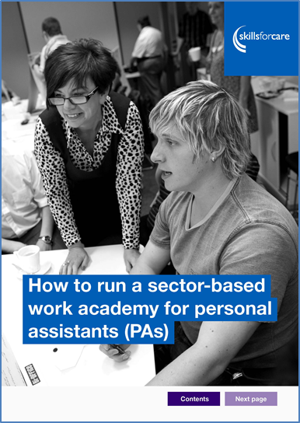
Sector-based work academies for PAs
In 2018/19 we funded four organisations to test a sector-based work academy for PAs:
Our online guide shares best practice from the pilots, and provides a step by step process that you can follow to set up and run an academy.
Find out more: www.skillsforcare.org.uk/SBWAforPAs
Notes:
A few years ago we funded four organisations to test using a sector-based work academy approach for PAs:
Leeds City Council
West of England Centre for Independent Living
Northern Independent Living CICI
Independent Lives
This led to the publication of a guide, taking the best practice and what had been learned by these projects.
People can also download and read the evaluation report from the pilot projects. Link in the main guide.

Slide 21
What is a sector-based work academy and how can it help?
A sector-based work academy is a type of pre-employment training programme that offers unemployed people the opportunity to do training and work experience.
It could be one way to attract and recruit more people to become PAs. It also:
gives people the chance to understand more about the sector and the PA role
helps people to see if the role is right for them, and they’re right for the role
helps employers to develop their skills and confidence

Slide 22
Individual service fund
An Individual Service Fund (ISF) is one way of managing a personal budget, where someone who needs care and support chooses an organisation to manage the budget on their behalf.
Our online guide shares key learnings and benefits of how to introduce and implement an ISF and how to overcome some of the challenges.
Find out more:
https://www.skillsforcare.org.uk/resources/documents/Employ-your-own-care-and-support-staff/ISF/ISF2020.pdf
Notes:
An Individual Service Fund (ISF) is one way of managing a personal budget, where someone who needs care and support chooses an organisation to manage the budget on their behalf. The organisation will help to plan support services and activities that will help them to achieve their identified outcomes.
Following a pilot project in South West England our guide shares key workforce learning and benefits of ISFs; how to introduce and implement them and how to overcome some of the challenges, as well as some of the learning and development implications.
The organisation will help to plan support services and activities that will help them to achieve their identified outcomes. This requires more flexible contracting between commissioning authorities and providers, and creative person-centred support planning to use personal budgets.
If you’re considering being involved in ISF’s download our guide from our website to find out more information.

Slide 23
Seeing Potential
See the person, value the difference
People from all backgrounds can have the right values to work in social care and bring a wealth of perspectives, ideas and ‘lived experience’ to your workforce.
www.skillsforcare.org.uk/seeingpotential
Notes:
Taking an open approach to your recruitment can help to:
attract a diverse range of candidates for your roles
secure a greater supply of people with the right values and behaviours to deliver high-quality, person-centred care
hire people previously under-represented in your workforce.
These resources have been developed for social care providers – but some of the concepts and information may be helpful and support employment of people with disabilities,
16 and 17 year olds
People with criminal convictions

Slide 24
Leaflet for social workers
Social workers might support people to assess and decide what care and support they want and need to access.
it’s important that people are told about all the options available to them, so that they can make an informed decision, including becoming an individual employer
this leaflet is for social workers and outlines the benefits of becoming an individual employer and how Skills for Care can help.
Information-for-social-workers-about-supporting-people-to-become-individual-employers

Slide 25
IE & PA workforce report: 2024
Key findings
Analysed 2,464 individual employer and 1,947 PA survey responses
* Care workers in the independent sector
Average | Social care | PHB funded | Care workers*
Jobs held by PAs | 1.29 | 1.2
Turnover rate | 19.9% | 23% | 37%
Vacancy rate | 11.4% | 13.4% | 13.1%
Zero-hour contract | 20% | 22% | 35%
Experience in role | 4.7 years | 4.1 years | 3.9 years
Hourly pay rate | £11.30 | £11.10 | £10.03
Sickness (prev. 12 months) | 2 days | 2.9 days | 5.8 days
Notes:
www.skillsforcare.org.uk/IEPAreport https://www.skillsforcare.org.uk/adult-social-care-workforce-data/Workforce-intelligence/publications/Topics/Individual-employers-and-personal-assistants.aspx
Link to PHB report produced in 2022/23: PHB report https://www.skillsforcare.org.uk/Adult-Social-Care-Workforce-Data/Workforce-intelligence/publications/Topics/Individual-employers-and-personal-health-budgets.aspx
This report for the first time include key data on IEs and PAs across health and social care.
Surveyed around 37,000 individual employers and PAs and analysed 2,464 individual employer and 1,947 PA survey responses from people with varying care needs, ages and from each region of England. This included 86% exclusively in receipt of a direct payment from a social care local authority, 10% exclusively in receipt of a personal health budget from the NHS. The remainder received a combination of direct payments from the local authority, self-funding, an NHS personal health budget or an Access to Work grant. This has created a strong foundation for producing statistics about this part of the sector within this report.
Key findings are on the slide, the report contains much more information about how PAs found their jobs, how easy or difficult it is to recruit, training and qualifications as well as other demographics.
Social care direct payment funded employers
Information from NHS England (formerly NHS Digital) SALT data return shows that around 220,000 adults, older people and carers were receiving social care direct payments from local authorities, in England, in 2022.
Skills for Care estimates that approximately 29% of social care direct payment recipients, or 65,000 individuals, directly employed their own staff.
The estimated proportion of direct payment recipients employing PAs has remained stable at around 30% between 2014 and 2021.
Social care direct payment funded employers employed, on average, 1.87 PAs each, creating an estimated 120,000 filled posts in 2021/22.
PAs of social care direct payment funded individual employers held an average of 1.29 PA filled posts each, meaning that around 90,000 people were carrying out 120,000 filled posts in 2021/22.
Personal health budget funded employers
A total of 144,682 people received personal health budgets by the end of Quarter three 2022-23. This included 128,067 adults and 16,615 children and young people.
Almost a fifth (19%) of all Personal Health Budgets were delivered as direct payments (27,343). And a significant number were used to directly employ PAs.
Currently no data is collected, at a national level, on numbers of personal health budget holders employing PAs or numbers of PAs employed. This means that creating an estimate of PAs working for personal health budget funded employers is not possible.
PAs of personal health budget funded employers worked for more than one employer, having, on average, 1.20 jobs each.

Slide 26
IE & PA workforce report 2024
Interactive data visualisations
Notes:
Data correct as of 2023/24 www.skillsforcare.org.uk/Adult-Social-Care-Workforce-Data/Workforce-intelligence/publications/Topics/Individual-employers-and-personal-assistants.aspx

Slide 27
PHB Quality Framework
Published Feb 2023: Set’s out the Role of ICBs
PHBs explained, incl. new definition and narrative for PHBs
I statements – what good looks like for people and families
Principles and enablers for PHBs
Quality Standards – strategic and operational delivery
Case studies
Additional support and resources
Each step of the PHB process explains: what it means for people and the quality standards
Notes:
Skills for Care worked with NHS England and other partners to develop the PHB Quality Framework. This has been developed to support best practice and should be useful to integrated care boards (ICBs) in a number of areas, including:
Providing clarity about their role and responsibilities in delivering PHBs
Setting out what they need to do to support partners to deliver high quality PHBs
Providing quality standards to measure PHB delivery against and improve delivery.
Keeping central to everything the overall aim of improving the experience and outcomes for people and families and
Enabling staff working to deliver PHBs to measure what they are doing against the quality standards providing the confidence to continue what they’re doing if it meets the quality standards in the framework, or improve what they’re doing if they are falling short.
And finally, ICBs can use the framework when developing their local strategic plan for implementing and expanding PHBs, aligned to system priorities and population health needs.
It’s not a lengthy document, it sets out:
Role of ICBs
PHBs explained, incl. new definition and narrative for PHBs
I statements – what good looks like for people and families
Principles and enablers for PHBs
Quality Standards – strategic and operational delivery
Case studies
Additional support and resources
Link to the document: https://www.england.nhs.uk/wp-content/uploads/2023/02/personal-health-budget-quality-framework.pdf

Slide 28
Other resources
Effective supervision www.skillsforcare.org.uk/supervision
Culturally appropriate care guide www.skillsforcare.org.uk/culturallyappropriatecare
Integrated workforce thinking across systems: practical solutions to support integrated care systems (ICSs) https://www.nhsemployers.org/publications/integrated-workforce-thinking-across-systems
Search 'care topics' on Skills for Care site for more
Notes:
Skills for Care, working in partnership with NHS Employers, and the Care and Health Improvement Programme, which is a collaboration between the Local Government Association (LGA) and Association of Directors of Adult Social Services (ADASS) has been involved in the development of a guide to support employers in integrated workforce thinking, in line with delivering the ICS strategy.
ICSs: This means engaging with them at all levels to ensure that plans and services can meet the needs of individual employers and that workforce plans include the development of the personal assistant workforce. As Integrated Care Systems (ICSs) develop, Skills for Care will use local/national engagement opportunities and networks to share updates and developments. For you attending today, consider if there are opportunities for you to also champion self-directed support and the PA workforce within different levels of Integrated Care Systems.
The Integrated Care System is where we also need to encourage individual employers to come together with a collective voice. If there are examples of where this is happening effectively, we’d be keen to know.

Slide 29
Local support
Skills for Care locality managers www.skillsforcare.org.uk/inyourarea
Local support organisation https://www.skillsforcare.org.uk/Recruitment-support/Support-individual-employers-PAs/Find-support.aspx
Notes:
For local support, you can contact a Skills for Care locality Manager. We have area teams across England who can signpost you to relevant information, tools and the availability of funding for learning and development.
As well as running workshops and networking events, locality managers work with organisations and facilitate access to our bespoke services.
Support from locality managers can be via phone or email, and you can find out who your locality manager by following this link.
You could contact your local support organisation to find out if there is a local network or peer support group in your area. You can find links to local support on our Information Hub.

Slide 30
Quarterly newsletter
Subscribe to our newsletter and to keep up to date, simply:
create an account on the Skills for Care website
select the 'Newsletter for individual employers and those who support them' option under the 'Contact preferences' section.
www.skillsforcare.org.uk/Employing-your-own-care-and-support/Sign-up-to-our-newsletter/Sign-up-to-our-newsletter.aspx

Slide 31
www.skillsforcare.org.uk/iepahub

